Slide 1
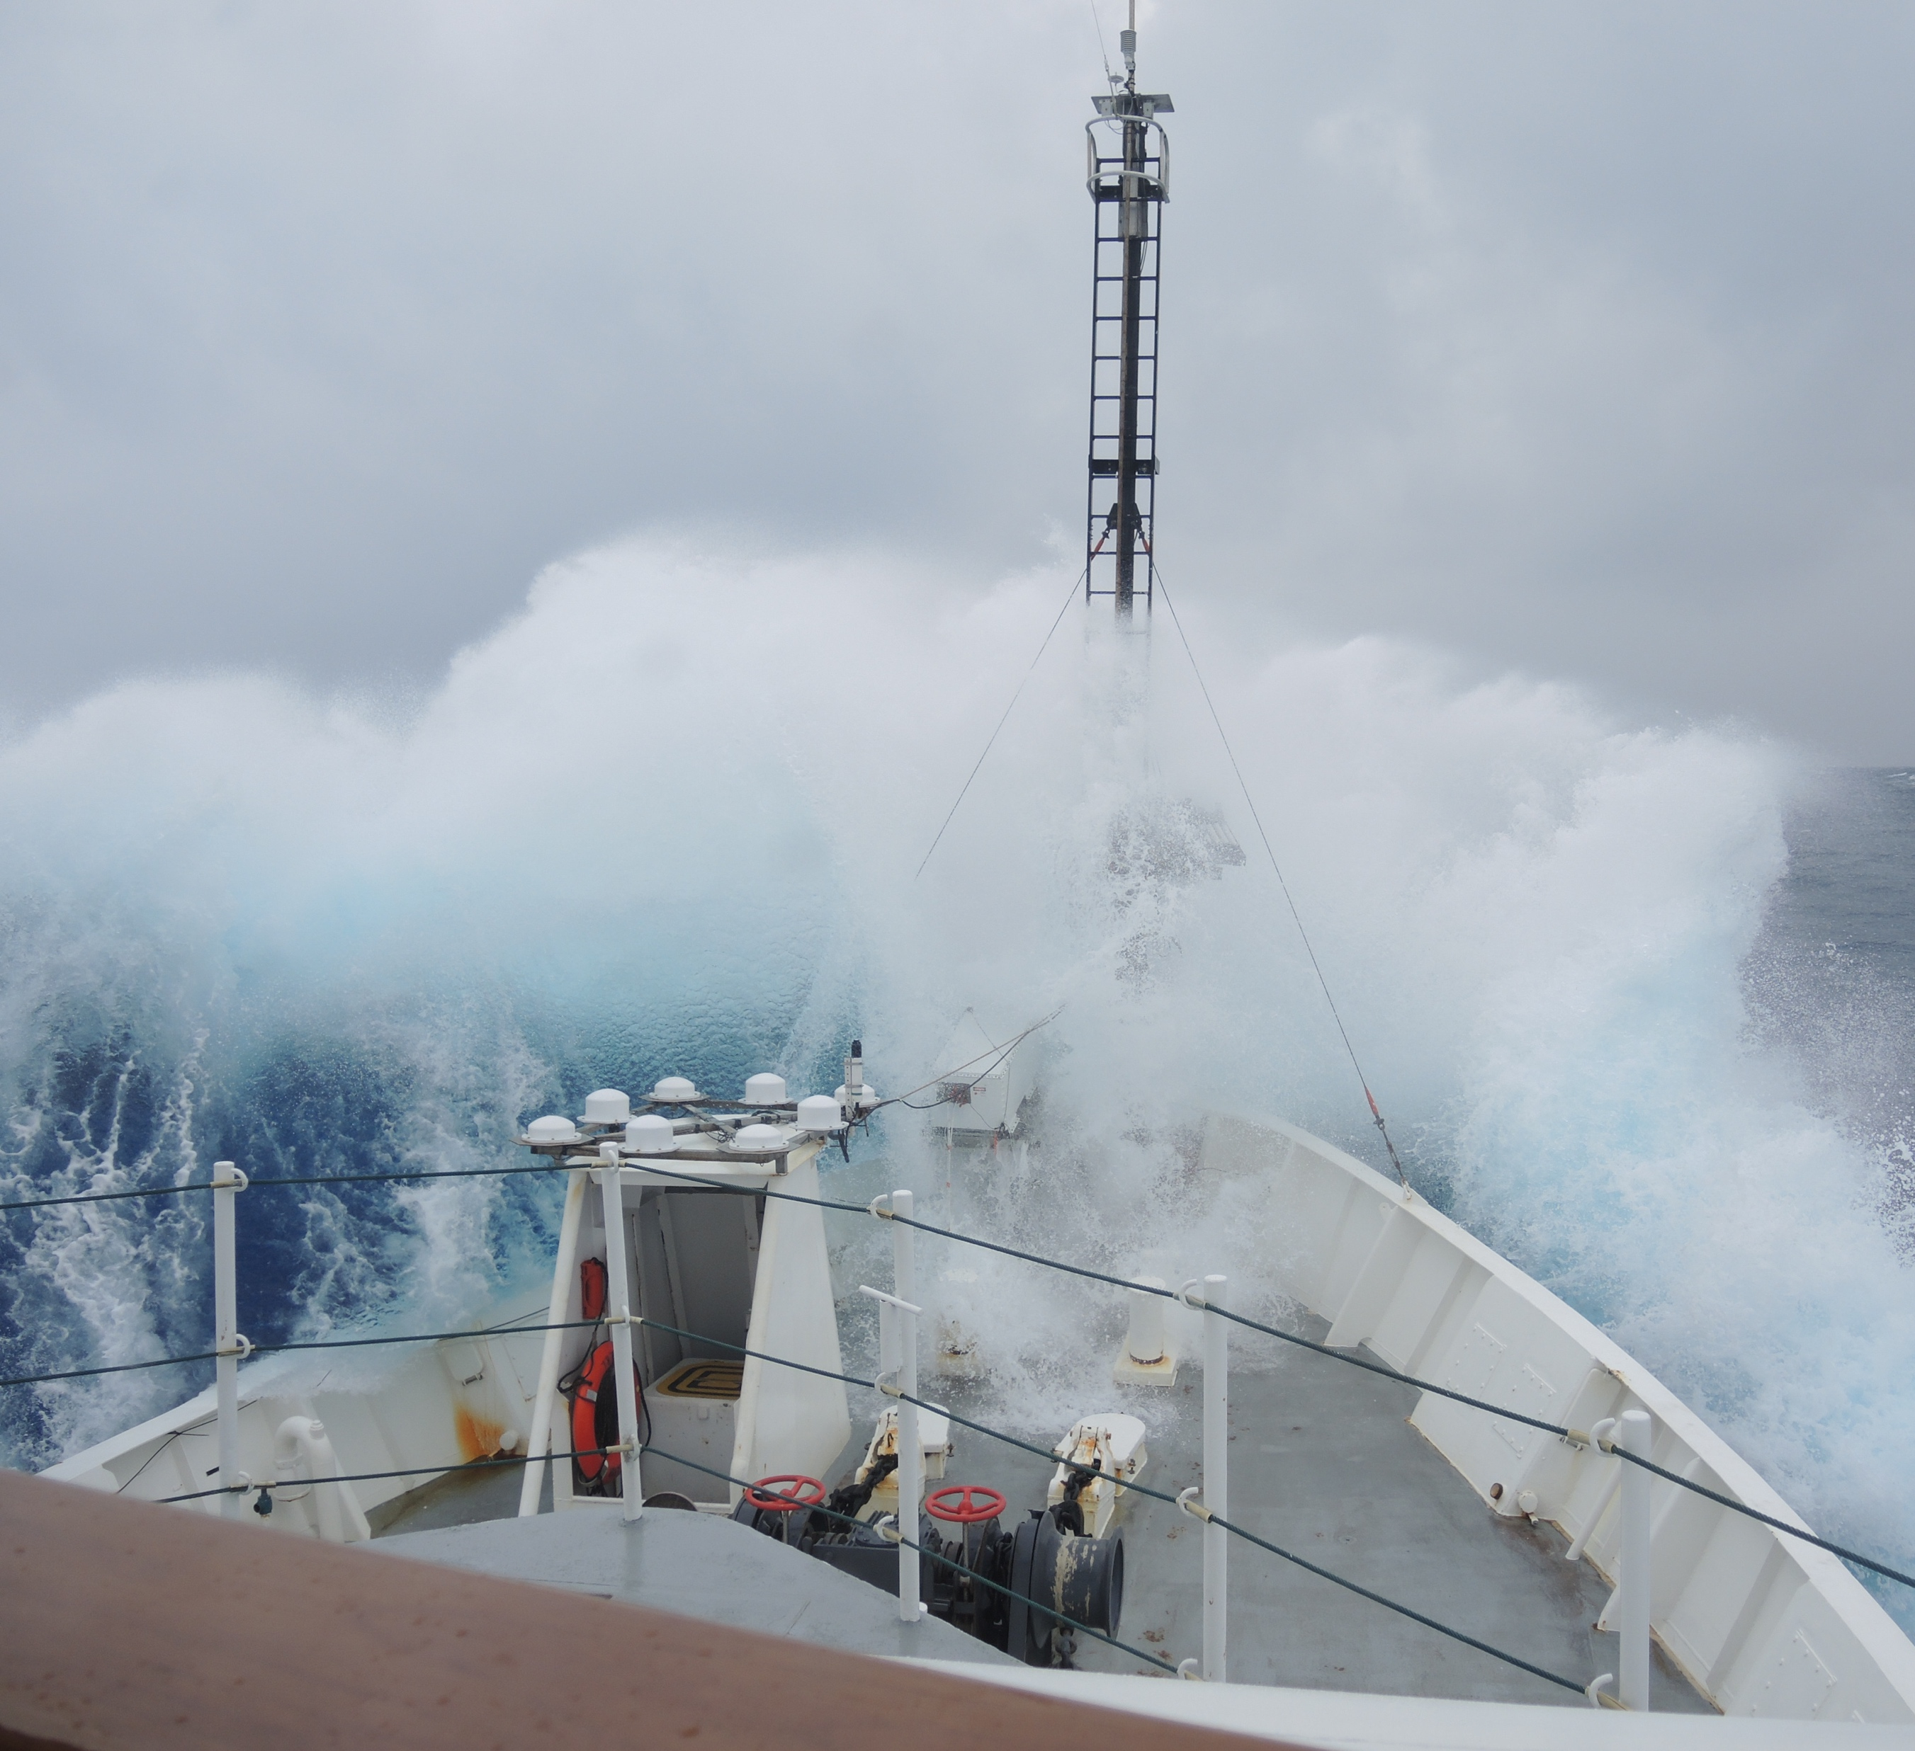
SABOR
The Ship-Aircraft Bio-Optical Research (SABOR) experiment used cutting edge technology in the air and the sea to verify and measure the amount and distribution of phytoplankton in different ocean environments.
Focus Area: Carbon Cycle and Ecosystems
Fast Facts
17 July - 7 August 2014
Used in-situ ship and remote airborne data to measure phytoplankton content in the ocean.
Research Questions Addressed
How are global ecosystems changing?
How will carbon cycle dynamics and terrestrial and marine ecosystems change in the future?
Follow-up Missions
NAAMES (5-27 November 2015; 11 May-5 June 2016)
Sea to Space (24 January-20 February 2017)
PACE satellite mission (2022)
For More Information
Paula Bontempi (paula.bontempi@nasa.gov)
https://espo.nasa.gov/sabor/content/SABOR
What did we learn?
Lidar-based depth-resolved data are critical for calculating phytoplankton stocks and carbon fluxes in the ocean.
Hyperspectral reflectance can be used to discern phytoplankton type.
The combination of lidar and polarization increases the accuracy with which we can see complex oceanic optical properties, such as how light penetrates and propagates through water.
Why is it important?
Phytoplankton form the base of the marine food web, release oxygen into the atmosphere, and absorb carbon dioxide; they are an important proxy for how the planet responds to atmospheric CO₂.
Understanding the amount, distribution, and especially the type of phytoplankton in the ocean will allow us to better understand how much carbon the ocean can store and determine the future health of oceanic ecosystems.
The research ship Endeavor battling waves. Image Credit: Ivona Cetinic
Notes:
1

